Slide 1

Search Dominance
PLAs & Extensions

Slide 2

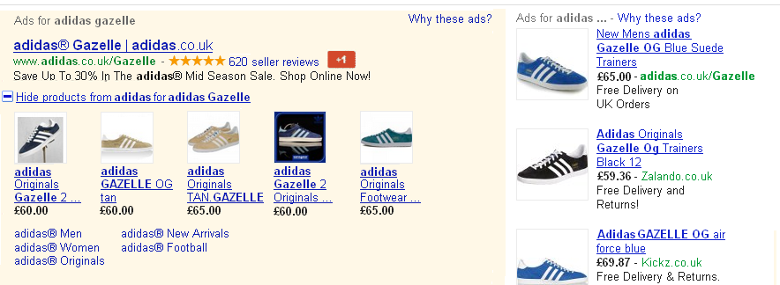

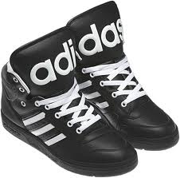
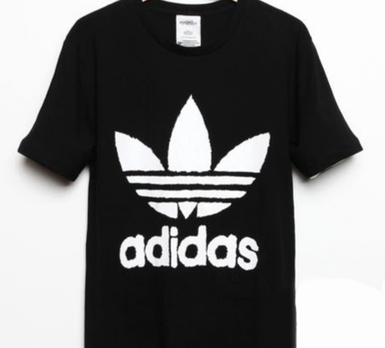
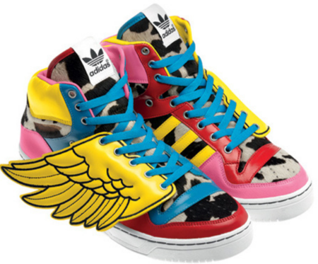
Background/Brief
The Vision…
Background
Adidas, Global leader in the sporting goods industry recognised the ever increasing competition within the search landscape for EU markets.
iProspect set out a vision to effectively leverage Product Extensions, Product Listings, Seller Reviews, Social Extensions & Sitelinks to Dominate the search landscape.
Seller Ratings & +1 Social Extension
Google Product Extensions & Product Listing Ads
Sitelinks

Slide 3




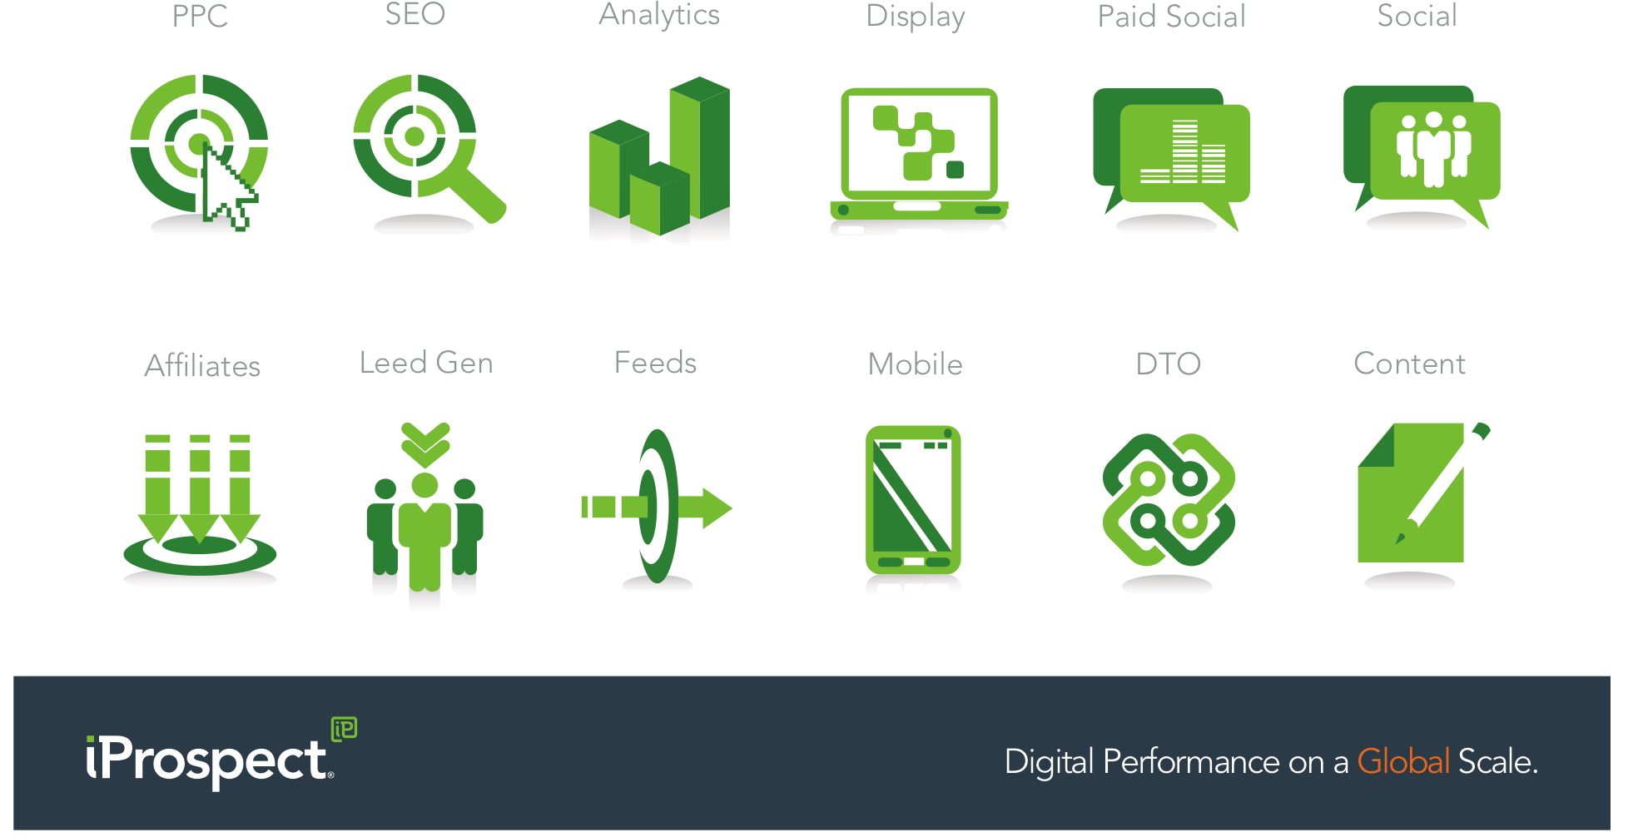
Challenge
CHALLENGES & SOLUTIONS
CHALLENGES
ADIDAS PRODUCT FEED NOT
OPTIMISED FOR PLA’s
NO INTEGRATION WITH ADWORDS
NO TRACKING SOLUTIONS FOR
PLA’s & EXTENSIONS FEATURE
NO PRODUCT REVIEWS
NO GOOGLE + PAGE
SOLUTIONS
iP UK & iP US WORKING CLOSELY
TO OPTIMISE ADIDAS FEED
LINKING MERCHANT CENTER WITH ADWORDS
TRACKING SOLUTION PROVIDED USING ADWORDS REDIRECTS
BEST PRACTICE GUIDELINES & SOLUTIONS PROVIDED TO KICK START PRODUCT REVIEWS & GOOGLE +

Slide 4

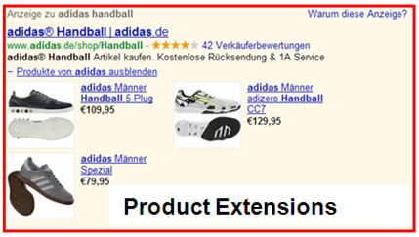
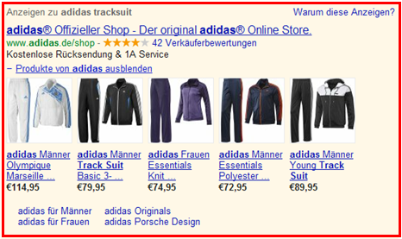
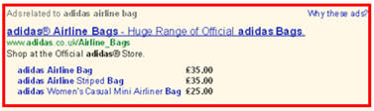

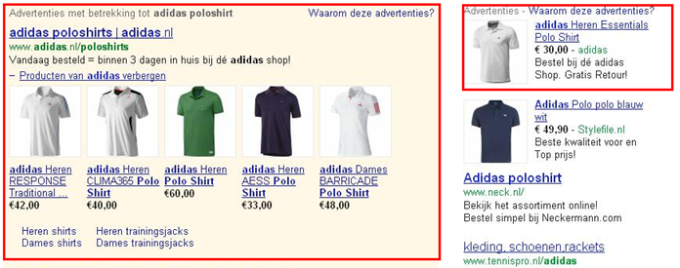

Strategy
Dominate The Search Landscape…
INTEGRATED OPTIMISATION
INCREASE RELEVANCY & PRODUCT INFORMATION TO PROVIDE BETTER USER EXPERIENCE.
SOCIAL EXTENSIONS & SELLER REVIEWS TO INCREASE CTR & CONVERSION RATE
INTEGRATED OPTIMISATION TO DRIVE & MAINTAIN TOP SELLING PRODUCT IN POSITION 1 USING TEXTS ADS, PRODUCT LISTING ADS & PRODUCT EXTENSIONS
EXPAND GENERIC KEYWORDS TO INCREASE AWERENESS & TRAFFIC
USING ADIDAS MERCHANDISING REPORTS & COREMETRICS INSIGHTS TO REFINE & OPTIMISE

Slide 5




results
RESULTS
⇧
*RESULTS
108%
INCREASE IN CONV RATE
13%
INCREASE IN CTR
“TJ and the London team worked well with our US based feeds team to optimise the set up for PLAs and Product Extensions.
I’m sure that PLAs and extensions are going to be an increasingly important part of our business moving forward and I’m looking forward to seeing the next developments.”
Emily Hardy
Snr Global Search Engine Marketing Manager Global eCommerce – adidas Group
BROADER REACH
IMPROVED SEARCH VISIBILITY
*CTR/Conversion Rate - based on 30 days pre-PLA/Extensions compared to 30 days post-PLA/Extensions

